Slide 1

His Body,
Our Bodies
1 Corinthians 15
Dr. Rick Griffith • Amman International Church
AmmanChurch.com & BibleStudyDownloads.org

Slide 2

Friday, 22 April 2022
Notes:
Happy Earth Day 2022!
OK, well, that was yesterday—and you thought it was Eastern Good Friday!

Slide 3
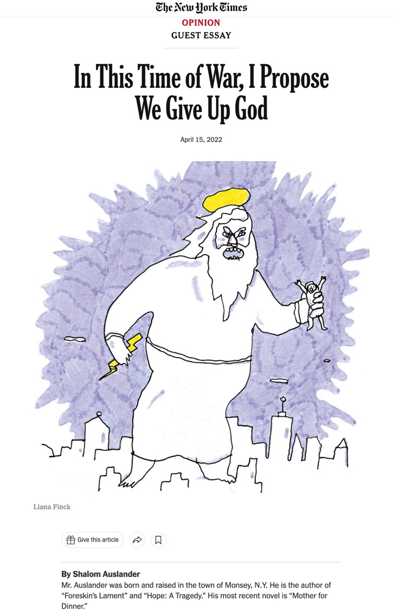
Give Up God
(2022 NY Times)
—Passover Issue
(= Good Friday)
Notes:
Blessed Easter to you! Not so for Shalom Auslander at the New York Times. His Passover article—same day as Western Good Friday this year—tells us to “Give Up God.”

Slide 4
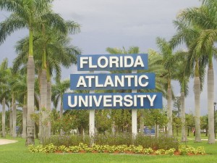
March 2013 at FAU
Notes:
Did you hear about March 2013 at Florida Atlantic University?

Slide 5
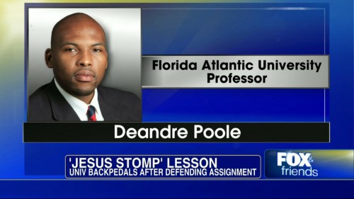
March 2013 at FAU
Notes:
Communications Professor Deandre Poole required students…

Slide 6
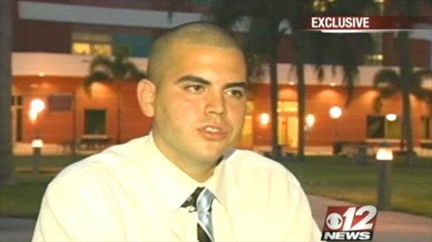
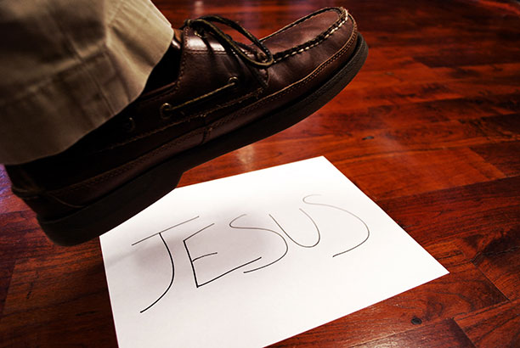
March 2013 at FAU
Notes:
…to stomp on a piece of paper with “Jesus” written on it to supposedly "discuss the importance of symbols in culture."
• But junior Ryan Rotela refused as it violated his religious beliefs. Dr. Poole immediately suspended him and a big to-do resulted. The school finally backed down after threats of legal action from the Christian Liberty Institute.

Slide 7
March 2013 at FAUX
PAUX
Notes:
The FAU became a FAUX PAUX.

Slide 8
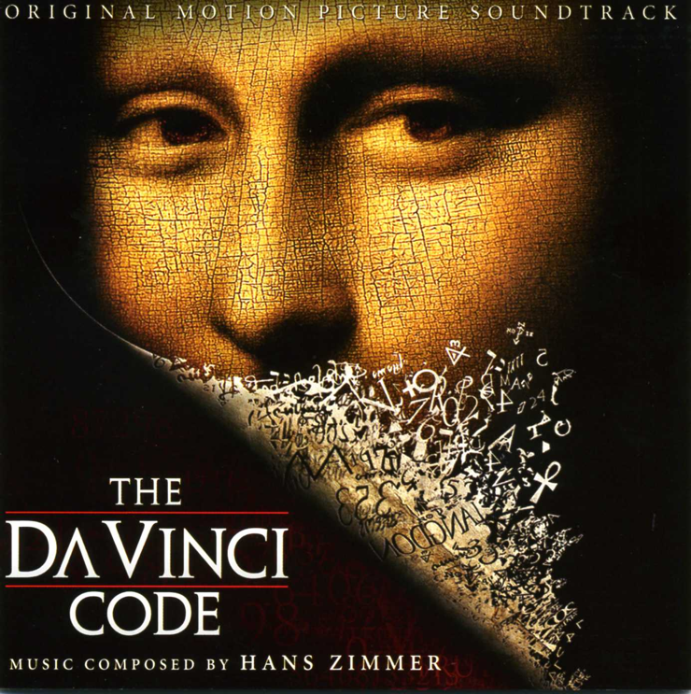

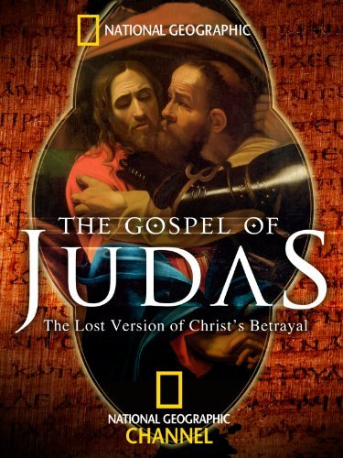
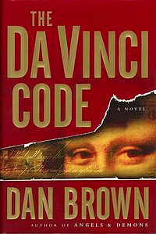
The month of March…
Notes:
Have you noticed that nearly every year there is an attack on Jesus in March?
• The Da Vinci Code rolled off the presses in March…
• Then years later the film came out in March.
• The Gospel of Judas attacked Jesus in March too. All of these are attacks on the death and resurrection of Jesus Christ.

Slide 9
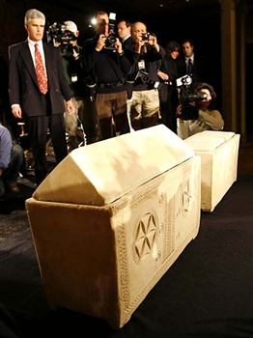
“The Bones of Jesus”
James Cameron
26 February 2007
REUTERS/Mike Segar
Notes:
In 2007 the media at a news conference in New York photographed two ossuaries—these are chests made for human bones. Why? Filmmaker James Cameron claimed that these ossuaries were found in a 2,000-year-old tomb in Jerusalem in 1980 and they may have held the bones of Jesus and “his wife,” Mary Magdalene. He claims that Jesus and Mary Magdalene may have even had a son named Judah.
26 Feb 2007 REUTERS/Mike Segar

Slide 10
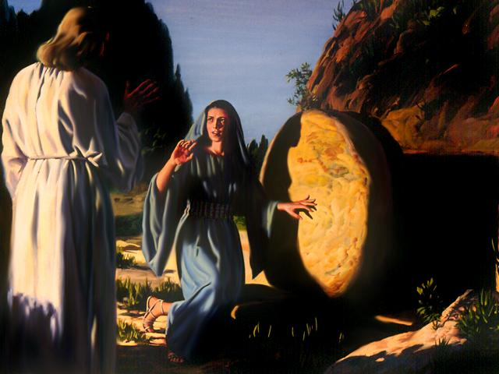
What difference does it make to you?
Notes:
I wonder if this concerns you. Would it really matter to you personally if they did find Jesus’ body? What would change in your life if this report was true?
Would a dead Jesus change how you invest your time?
Does the resurrection of Christ affect how you spend your money?
Would it affect your marriage?
What would change—for you—if anything?

Slide 11
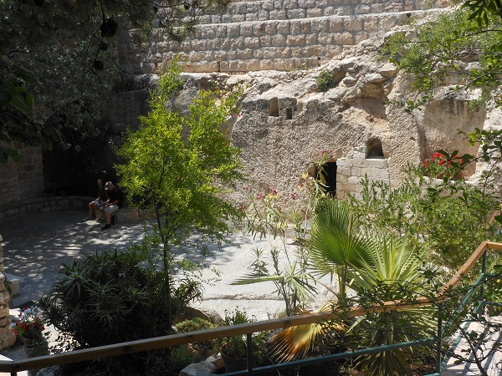
The Garden Tomb
Notes:
Of course, we know that Jesus did rise from the dead—like He said He would!
Did you hear that someone asked the owner of the tomb, Joseph of Arimathea, “That was a great tomb. Why did you give it to someone else to be buried in?”
“Oh,” Joseph said, “He only needed it for the weekend.”
The resurrection is a fact! But…

Slide 12
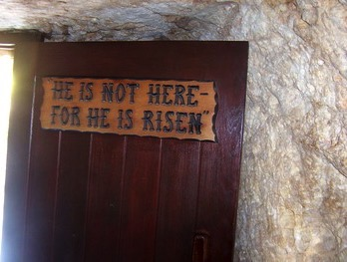
He is not here – for he is risen
What's so important about Christ's resurrection?
Notes:
What’s so important about Christ’s resurrection? Why should it matter to you and me that Jesus arose?

Slide 13
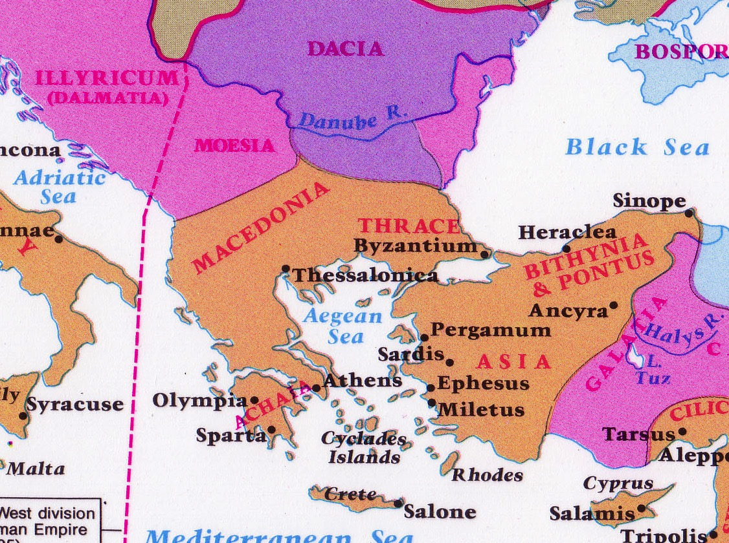
Philosophies at Athens
Athens
Corinth
Notes:
Paul addressed this issue to some people who doubted the resurrection.
They lived in ancient Corinth—a seaport city where a lot of ideas floated around.

Slide 14
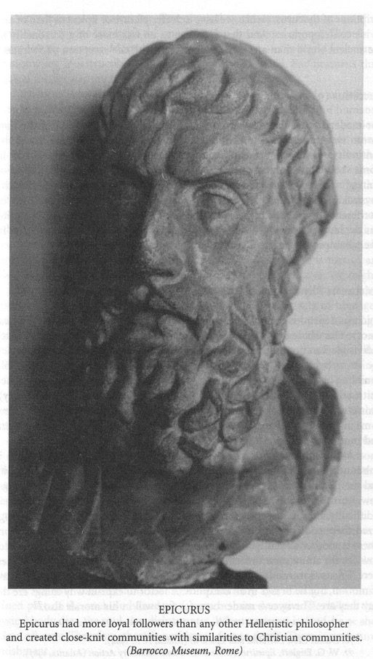
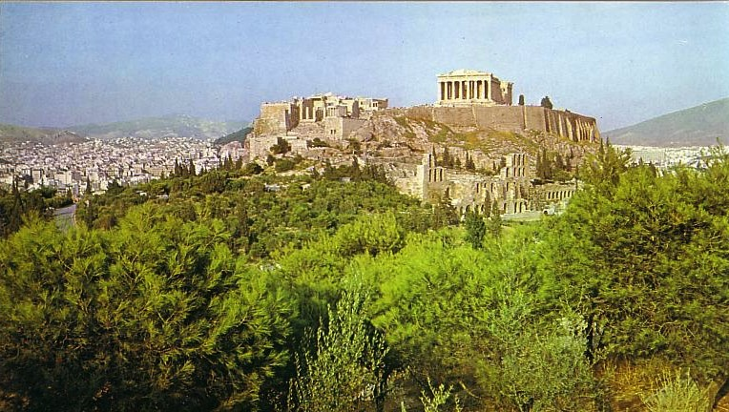
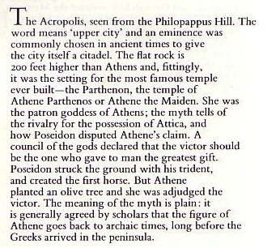
Epicureans & Stoics at the Parthenon
"Eat, drink, and be merry
—for tomorrow we die!"
Notes:
Nearby philosophies like Epicureanism and Stoicism influenced many people in Corinth to scoff at the idea of bodily existence after death, so some of the Corinthian Christians had even followed this line of doubt.
• Epicurus was known to have said, "Eat, drink, and be merry—for tomorrow we die!" He was saying that after death there is no accounting for our lives on earth—no resurrection.

Slide 15
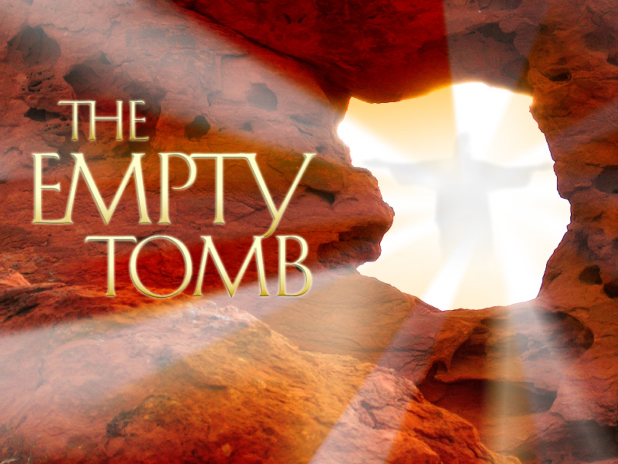
Why is it important?
3 reasons
Notes:
But Paul took this denial of the resurrection very seriously! So let’s see
• three reasons Paul says Christ’s resurrection is important in 1 Corinthians 15. First…

Slide 16
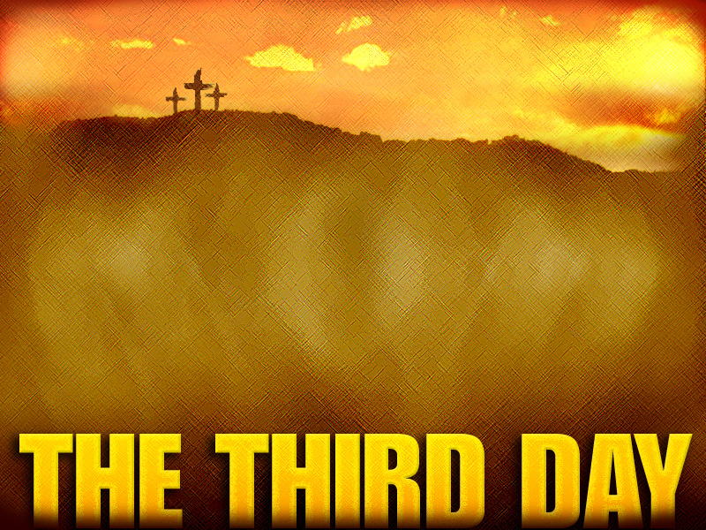
I. Christ's resurrection is a key part of the gospel
(1 Cor. 15:1-11).
Notes:
[You don’t have the true message of salvation without a living Jesus!]

Slide 17
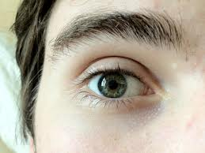
"Now, brothers, I want to remind you of the gospel
I preached to you…
For what I received I passed on to you of first importance…"
(1 Cor 15:1a, 3a NIV)
Notes:
The gospel is so vital that our faith is founded on it (1-3a).
The Corinthians, like us, received the gospel for salvation (1-2).
The gospel was the most vital doctrine they knew (3a; NLT “I passed on to you what was most important”).

Slide 18
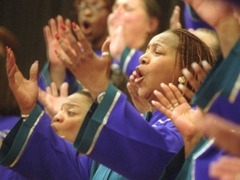
What's the Gospel?
Notes:
Is "gospel" a type of music?

Slide 19
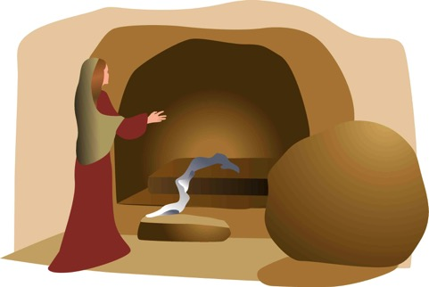
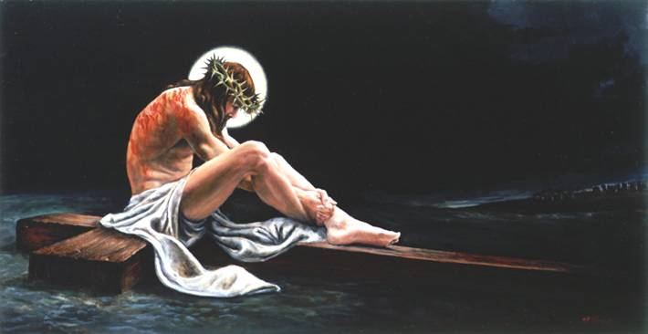
The Full Gospel
“Let me now remind you… of the Good News [Gospel] I preached to you before…” (NLT)
Burial
Risen
Death
“Christ died for our sins…”
“He was raised from the dead on the third day…”
“He was buried…”
1 Cor. 15:3-4
Notes:
The gospel has three key elements (3b-8):
Christ’s death fulfilled Isaiah 53 to show He bore our sins rather than His own (3b).
Christ’s burial proved He really died (4a).
Christ’s resurrection and appearances proved Him to be the Messiah prophesied by the OT (4b-8).

Slide 20

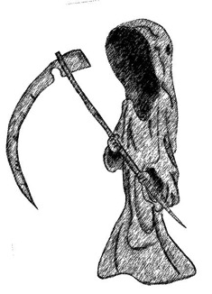
What's the Difference?
Dead
Alive
Notes:
The resurrection makes Jesus unique among the world’s religious leaders—not even ONE of them died and rose again! All are either alive today or still dead.

Slide 21
What's the Difference?
⁵He was seen by Peter and then by the Twelve. ⁶After that, he was seen by more than 500 of his followers at one time, most of whom are still alive, though some have died. ⁷Then he was seen by James and later by all the apostles.
Dead
Jesus
Alive
Notes:
Jesus proved his resurrection with at least 11 appearances.
OPTIONAL:
Also, the gospel of Christ being alive today brings salvation to all who believe (9-11).
1Cor. 15:9-11 NLT ⁹ For I am the least of all the apostles. In fact, I’m not even worthy to be called an apostle after the way I persecuted God’s church. ¹⁰ But whatever I am now, it is all because God poured out his special favor on me—and not without results. For I have worked harder than any of the other apostles; yet it was not I but God who was working through me by his grace. ¹¹ So it makes no difference whether I preach or they preach, for we all preach the same message you have already believed.

Slide 22
He is not here – for he is risen
What's so important about Christ's resurrection?
Notes:
What’s so important about Christ’s resurrection? Why should it matter to you and me that Jesus arose?

Slide 23
I. Christ's resurrection is a key part of the gospel
(1 Cor. 15:1-11).
Notes:
[You don’t have the true message of salvation without a living Jesus!]

Slide 24

II. Christ's resurrection will resurrect us in new bodies later (12-57).
Notes:
[Since Christ rose, you will too!]

Slide 25
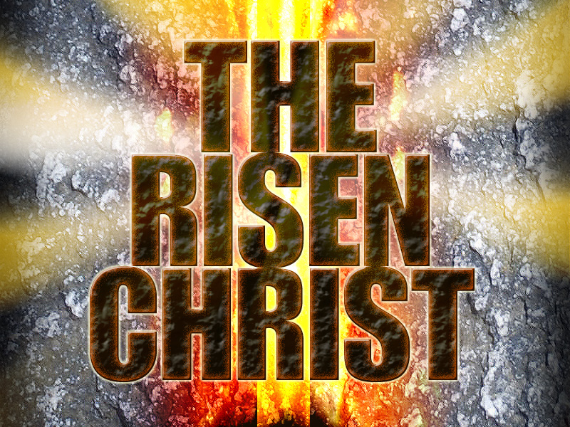
We teach…
Notes:
His resurrection gives us hope in our own resurrection (12-34).
Some Corinthians believed that Christ rose but believers won’t (12).

Slide 26
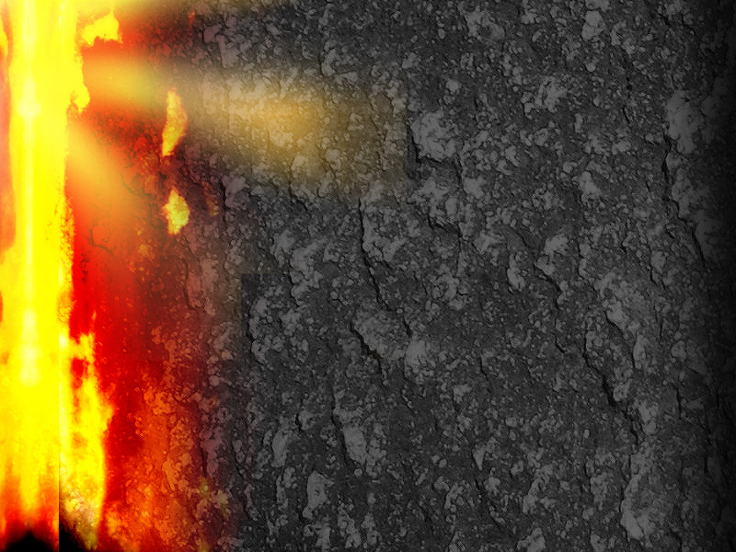
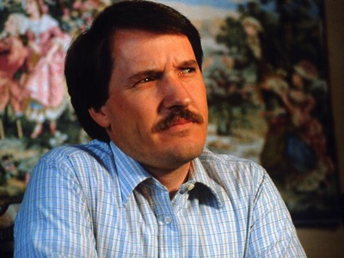
Doubting the resurrection leads to hopelessness (12-19)
• Both resurrections stand or fall together (12-13)
• Preaching/faith useless (14)
• Preachers are liars (15-16)
• No forgiveness (17)
• No heaven (18)
Notes:
If Christ didn’t rise, then we have no hope (13-19).
• Our resurrection and Christ’s resurrection stand or fall together (13).
• If Christ didn’t rise, then Christian preaching and faith are useless (14).
Why? Because Christians have always preached a living relationship with the person of Christ.
Have you ever had a relationship with a dead man? So if Jesus is still dead, it would be useless to preach about knowing Him.
• If Christ didn’t rise, then preachers are liars (15a-16).
No other religion claims an empty tomb for its founder.
If this is false then Christians have deceived over a billion people to believe a lie.
• If Christ didn’t rise, then you aren’t forgiven (17). Why not? Because the resurrection proves that Christ died for our sin rather than for His own.
• If Christ didn’t rise, then dead believers are doomed to hell—because they never were forgiven (18).

Slide 27
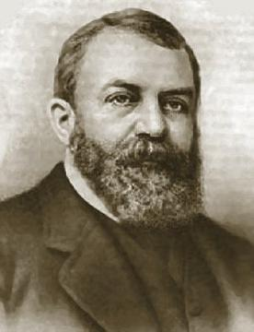
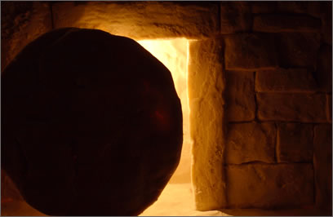
Black
Notes:
If Christ didn’t rise, then our hope lasts only for this life—because if our founder didn’t defeat death, then neither will we (19a)!
As a young man, D. L. Moody was called upon suddenly to preach a funeral sermon. (Tan 5021)
He hunted through all four gospels to find one of Christ’s funeral sermons—only to discover that Christ broke up every funeral He ever attended! He raised each corpse back to life!

Slide 28
Doubting the resurrection leads to hopelessness (12-19)
• Both resurrections stand or fall together (12-13)
833 martyrs daily!
• Preaching/faith useless (14)
• Preachers are liars (15-16)
• No forgiveness (17)
• No heaven (18)
• Most pitiful creatures (19)
Notes:
If Christ didn’t rise, then we should be pitied more than anyone else (19b).
Nowadays 833 people are killed daily for believing in a risen Christ!
What a tragedy if there’s no bodily afterlife!

Slide 29

Notes:
(So the risen Jesus gives us HOPE instead of hopelessness. But what other results come since Christ did rise?)

Slide 30
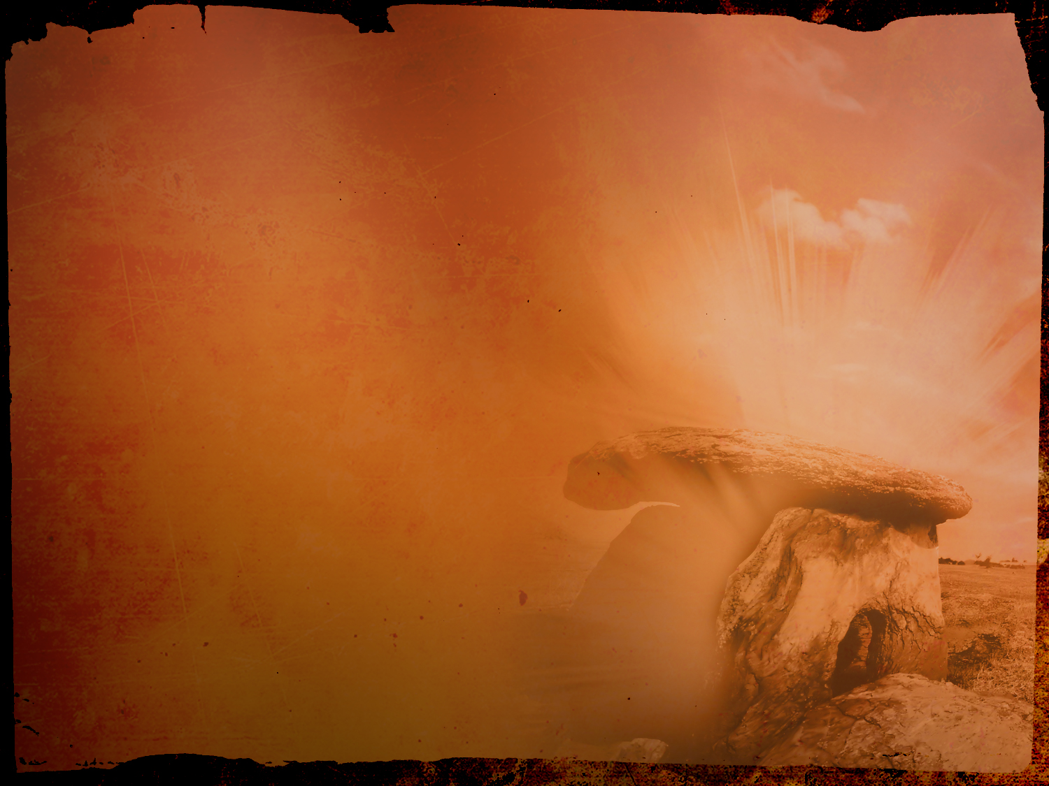
Believing the resurrection leads to hope (20-28)
• Hope for resurrection (20-23)
• Will reign with Christ (24-27a)
• Kingdom over all (27b-28)
Let's see each of these…
Notes:
Since Christ did rise, we will rise and reign with Him (20-28).

Slide 31
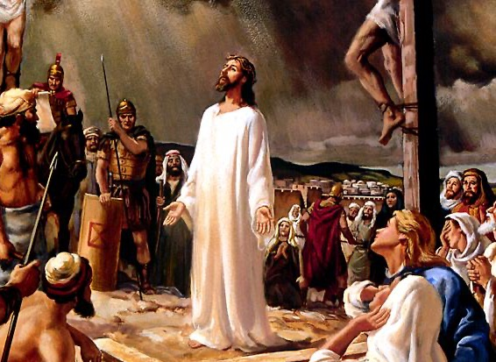
Hope for our resurrection comes from His victory over the cross (20-23)
Notes:
His resurrection gives hope that millions more will also rise at His return (20-23)—

Slide 32
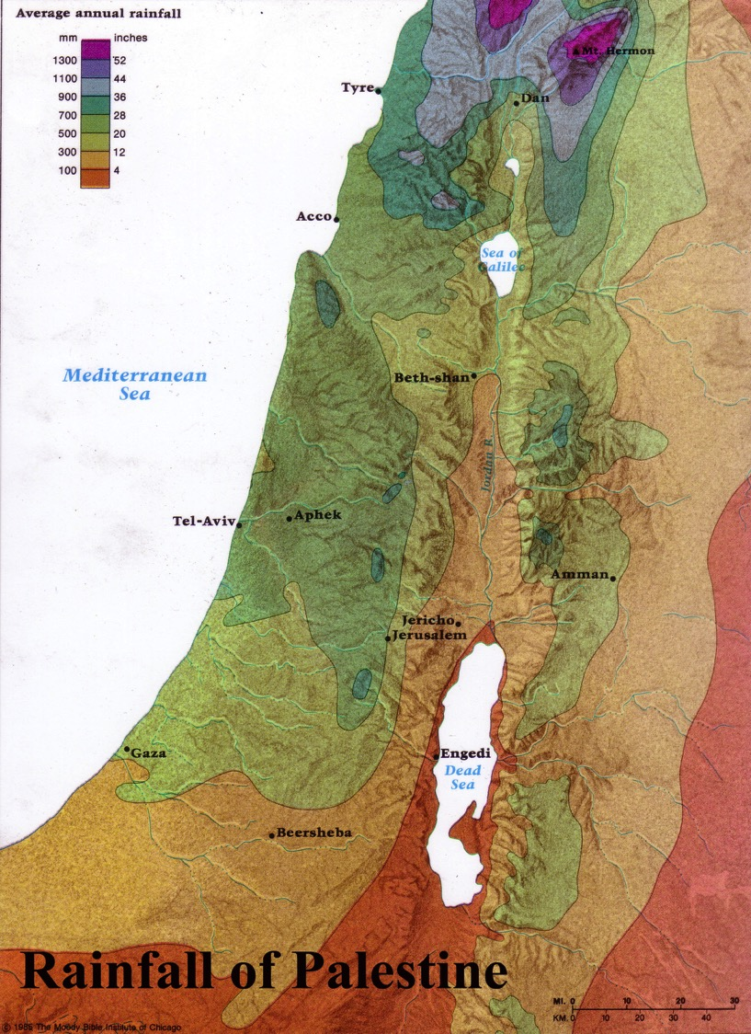
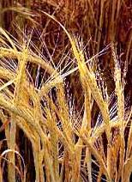
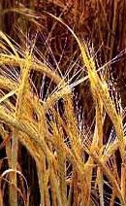
Firstfruits: Wave Sheaf Offering
Harvested in the far north of Israel
Brought down to Jerusalem
Notes:
—as the first fruit sheafs brought to Jerusalem…

Slide 33
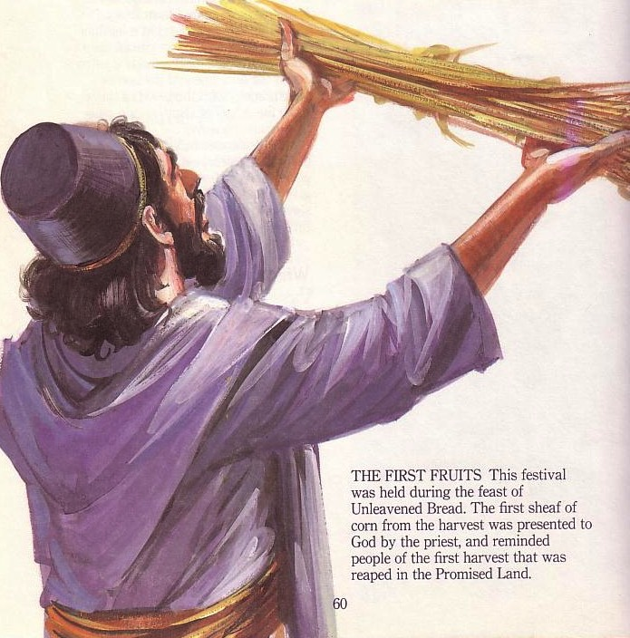
Firstfruits
Temple Offering
Harvested in the far north of Israel
Brought down
to Jerusalem
Waved before
the LORD
Notes:
…so Jesus is the first raised!

Slide 34
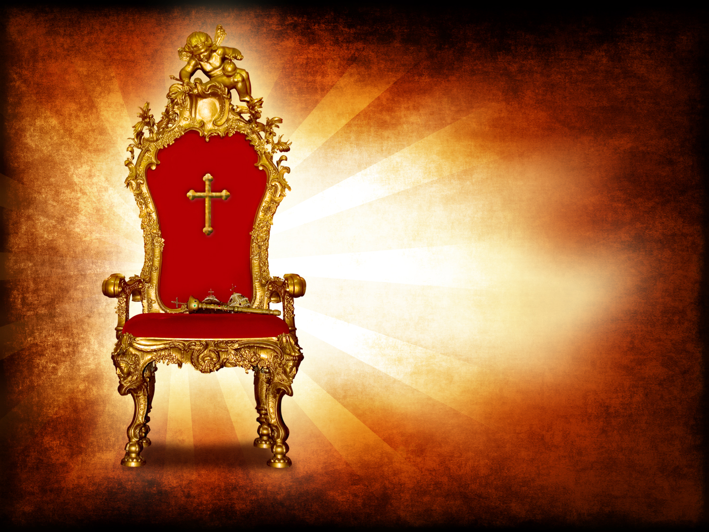
• We will reign with Christ
(24-27a)!
Notes:
His return will result in His reign until He subdues every power (24-27a).

Slide 35
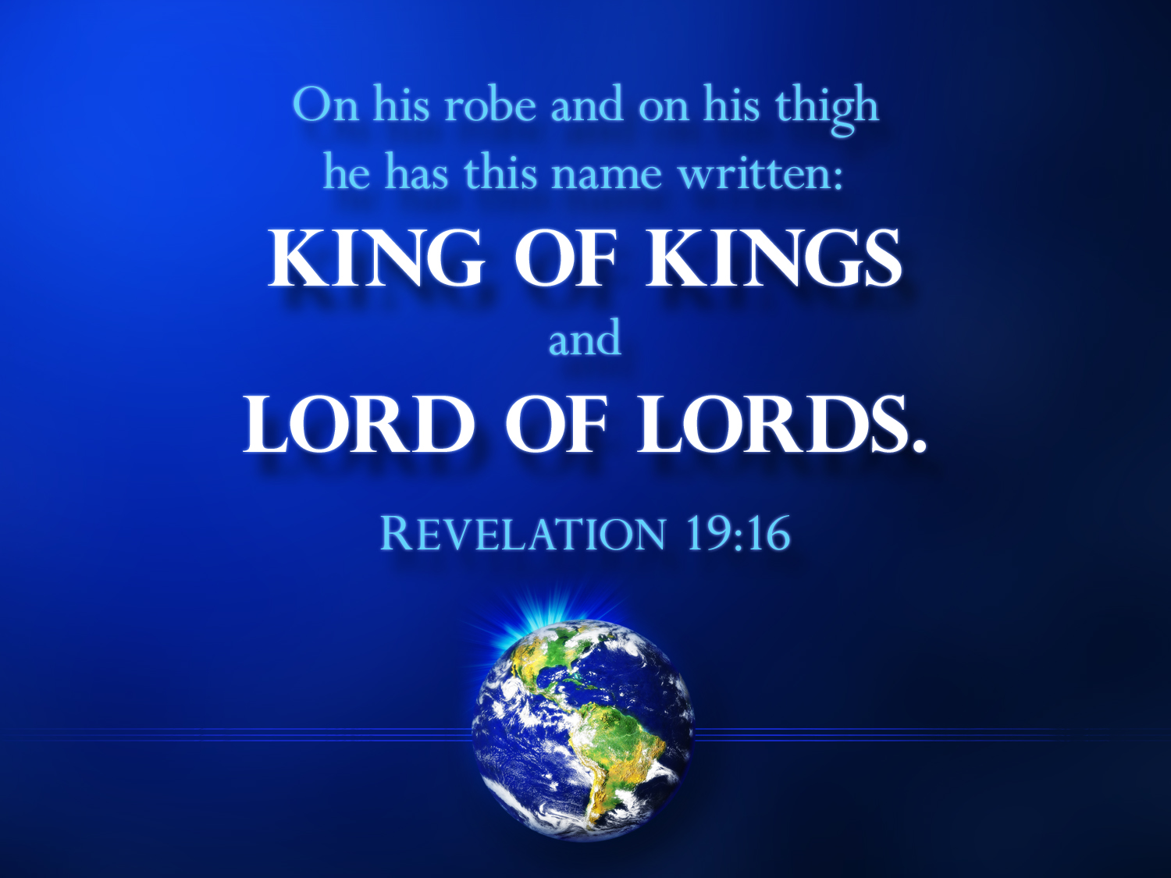
His kingdom will be over all (27b-28)
Notes:
Christ will then hand His kingdom over to the Father so that the Triune God will be shown sovereign over everything (27b-28).

Slide 36
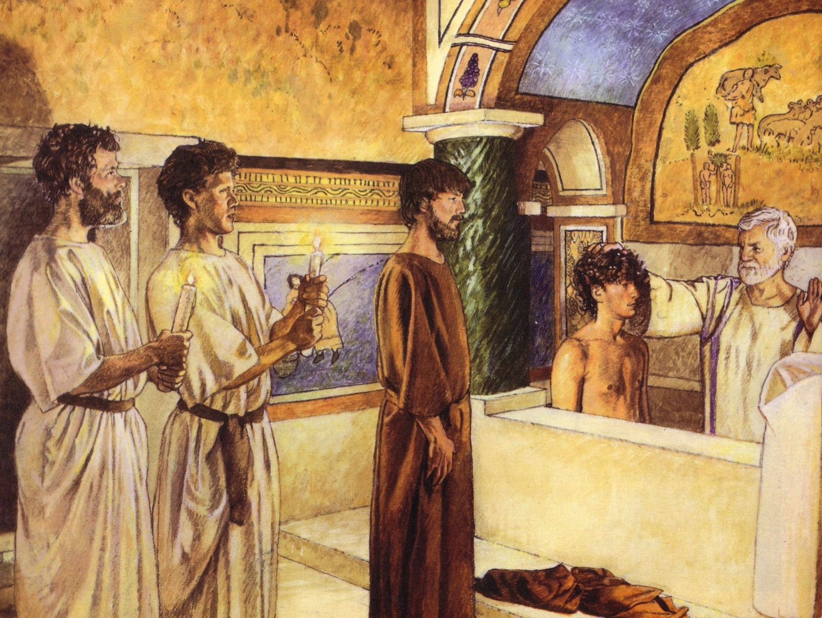
First Century Christian Baptism
In memory of believers who had died
Notes:
More dismal things result if Christ’s resurrection is false (29-32).
New Christians baptized in the name of believers who died did so in vain (29). This probably refers to baptizing Christians for believers who had died—not to save them, but to take their places in the church.
Persecuted Christians should live for pleasure—if no resurrection (30-32).

Slide 37
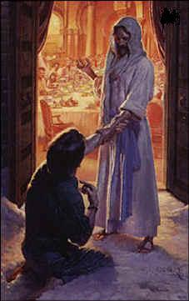
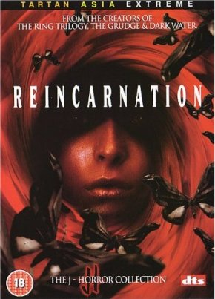
Resurrection?
or…
Notes:
We should be ashamed to believe false teachers who deny the resurrection (33-34).
We have all kinds of people around us who don’t believe in resurrection—they hold to reincarnation!

Slide 38
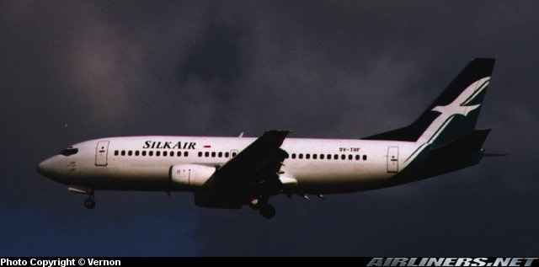
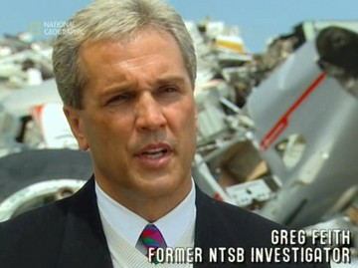
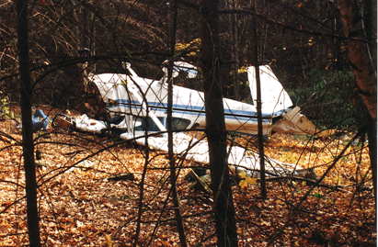
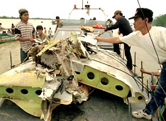
Silk Air MI 185 Crash
19 December 1997
Notes:
This struck me in 1997 when reading a website on how one’s religion helps him or her deal with a recent SilkAir MI185 crash. One respondent—president of the Singapore Buddhist Foundation—noted…
_______
On 19 December 1997, a SilkAir Boeing 737- 300 en route from Jakarta to Singapore crashed near Palembang, Sumatra. All 97 passengers on board, the five cabin crew, Captain Tsu Way Ming and co- pilot Duncan Ward died in the crash. The Jakarta to Singapore flight never made it—and no one can say for sure why it crashed in Indonesia.

Slide 39
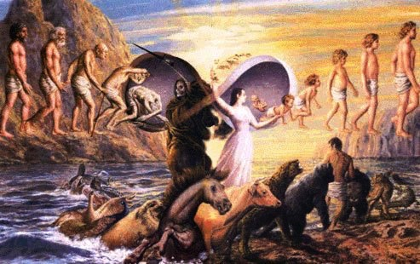
“Hope” in reincarnations…
"What is in store in your next life depends on what you do in this one… If [you don’t share your wealth with others], you could be born into the world of the hungry ghosts or be reborn as an animal….At times of tragedies and sudden deaths, it helps to regard death as escape from this imperfect world to a possibly better next life, so surviving relatives can find peace in their loss."
—President of the Singapore Buddhist Foundation
Notes:
This viewpoint is filled with admirable compassion, but ultimately little hope—perhaps you'll be an animal or human and possibly have a better next life? Not much comfort indeed…

Slide 40
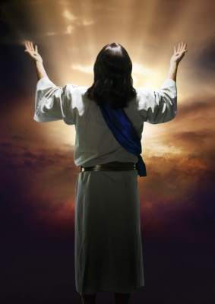
What does hope in Christ offer us instead?
Notes:
(But what does the resurrection of Christ offer us instead? Verses 35-57 show where it really gets good! It says that…)

Slide 41
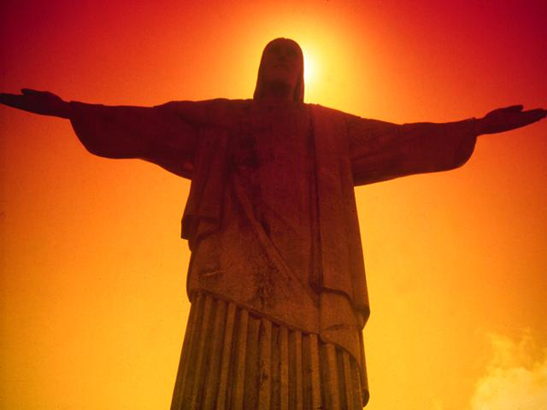
Christ's resurrection will give us bodies that far outshine our earthly bodies (35-57).
Notes:
Jesus had a superior body after his resurrection—and so will we!

Slide 42
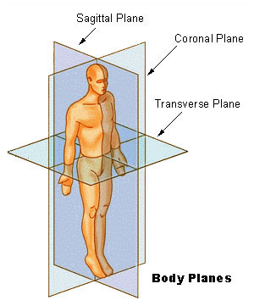
Perfect Bodies!
Notes:
Since the resurrection is true, the next question is what kind of body it will be (35).

Slide 43
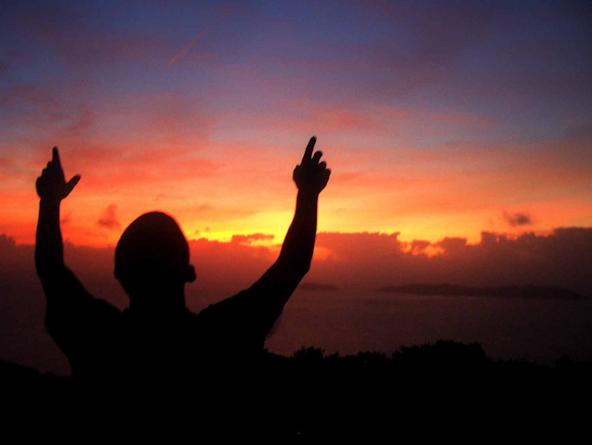
Three Illustrations of Our New Bodies:
• Plant Life (36-38)
• Animal Life (39)
• Inanimate Objects (40-41)
Notes:
Paul illustrates the superiority of the resurrected body three ways from nature (36-41)…

Slide 44
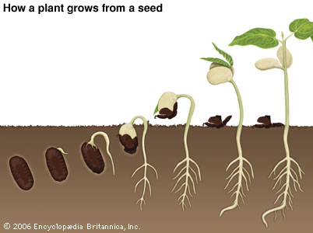
• Plant Life (36-38)
How a plant grows from a seed
Notes:
Plant life shows that the first body (the seed) is far inferior to the second body—the grown plant (36-38).

Slide 45
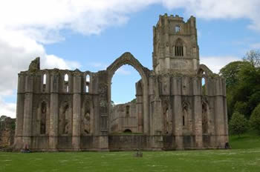


• Plant Life (36-38)
Built
AD 1120
856
years old!
Found
AD 1976
Notes:
• In 1976 a seed was found inside an abbey wall in England
• from the year 1120.
• That made it an 856-year old seed! Someone planted it,
• and it grew into a beautiful rose bush! Think of all that potential preserved in that dead seed!
Now think of our bodies as seeds. Despite our age or form, at the resurrection we will “bloom” into the most beautiful bodies ever seen!
—Tan 5037

Slide 46




• Animal Life (39)
Notes:
Animal life shows that the flesh of each species differs from the others (39).
In 1999 a dove flew into our yard with crippled wings and our dog devastated its back, pulling out about 50 feathers.
• It looked like a chicken ready for roasting!
• One of our boys rescued it, though, and we nursed it back to health in a cage. Within two weeks all the feathers grew back and we saw it fly away to freedom.
• God knows just what kind of skin to give the bird and the fish and us.

Slide 47


• Inanimate Objects (40-41)
Earthly bodies
Heavenly bodies
Notes:
Inanimate objects of the earth (mountains, canyons, seas?) are inferior in glory to heavenly bodies—sun, moon, stars (40-41).

Slide 48

The Resurrected Body (42-57)
Notes:
Paul elaborates on the superiority of the resurrected body over the earthly body (42-57).

Slide 49

Resurrection is better (42-44a)!
42—die…
…to never die!
43a—sin…
…to never sin!
43b—weak…
…to powerful!
44a—physical…
…to spiritual!
Notes:
• Bodies that can die now will be raised as bodies that will never die (42).
• Sinful bodies will be raised as bodies that will never sin (43a).
• Weak bodies will be raised as powerful bodies—like the ant lifting many times its body weight (43b)!
• Physical bodies will be raised as spiritual bodies (44a).

Slide 50



Black
Notes:
Imagine grieving caterpillars carrying a cocoon shell to its resting place.
The poor, distressed caterpillars, clad in black raiment, weep as they trudge on, mourning the loss of their beloved friend.
• Yet above them flies the beautiful butterfly fluttering happily above the muck and mire of the earth—forever freed from its earthly shell! Tan 5035
That’s what it will be like to get these new bodies!

Slide 51

LORD of Lords
Notes:
(How quickly will you trade your earthly for your heavenly body? Instantly!)

Slide 52

We shall not all sleep…
Notes:
Sometimes babies have this verse on their clothes which is their promise in the church nursery: "We shall not all sleep—but we all shall be changed!"

Slide 53

We will join him in the clouds

Slide 54

Black
Notes:
And we shall instantly be changed!

Slide 55

1 Cor 15:55 Text
Notes:
The sting of death finally will be defeated.

Slide 56

III. Our future resurrection should spur us to serve Him confidently now
(1 Cor 15:58).
• Stand firm in the resurrection
• Don't let anyone shake your faith
• Serve Christ wholeheartedly
• You'll be rewarded
Notes:
[Since we know we’ll rise then, we should rise to service now!]
NIV 1Cor. 15:58 Therefore, my dear brothers, stand firm. Stand firm in what? In the resurrection!
• Let nothing move you. Does this mean to be stubborn about everything? No. Don't let anyone shake your belief in the risen Jesus.
• Always give yourselves fully to the work of the Lord—don't be half-hearted in serving Jesus.
• because you know that your labor in the Lord is not in vain. You support a truth—the resurrection of Jesus and your future resurrection—so you are not wasting your life to serve Christ. You will be rewarded.

Slide 57
He is not here – for he is risen
What's so important about Christ's resurrection?
Notes:
What’s so important about Christ’s resurrection? Why should it matter to you and me that Jesus arose?

Slide 58

Since Christ rose, you will too! So live like it!
The Main Idea…
Notes:
Jesus is alive today—since he also will make us alive again after death, serve him now until death.

Slide 59


Resurrection life!
"…stand firm…give yourself fully to the work of the Lord, because you know that your labor in the Lord is not in vain" (15:58 NIV)
Notes:
But what does a “resurrection life” look like?
Verse 58 says to “give yourself fully to the work of the Lord”! Do you serve Him with all of your might?
“Resurrection life” has hope too. Don’t be like these Corinthians who lost hope (Gospel presentation).

Slide 60
Black

Slide 61


NT Preaching link at BibleStudyDownloads.org
Get this presentation and script for free!
Notes:
NT Preaching (np)

